Slide 1
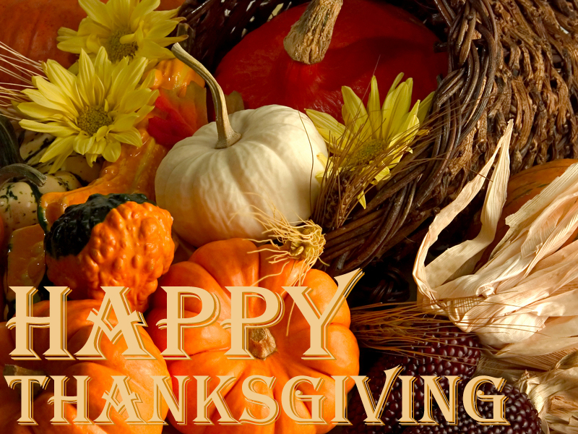

Slide 2
On the fourth Thursday in November the Americans celebrate the holiday called Thanksgiving.
It is a national holiday.

Slide 3
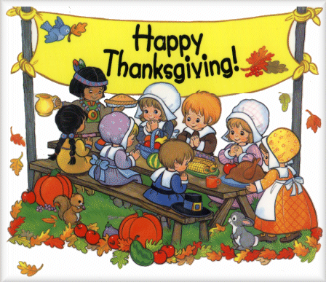
Thanksgiving day symbolizes the joy of loving, caring, sharing.

Slide 4
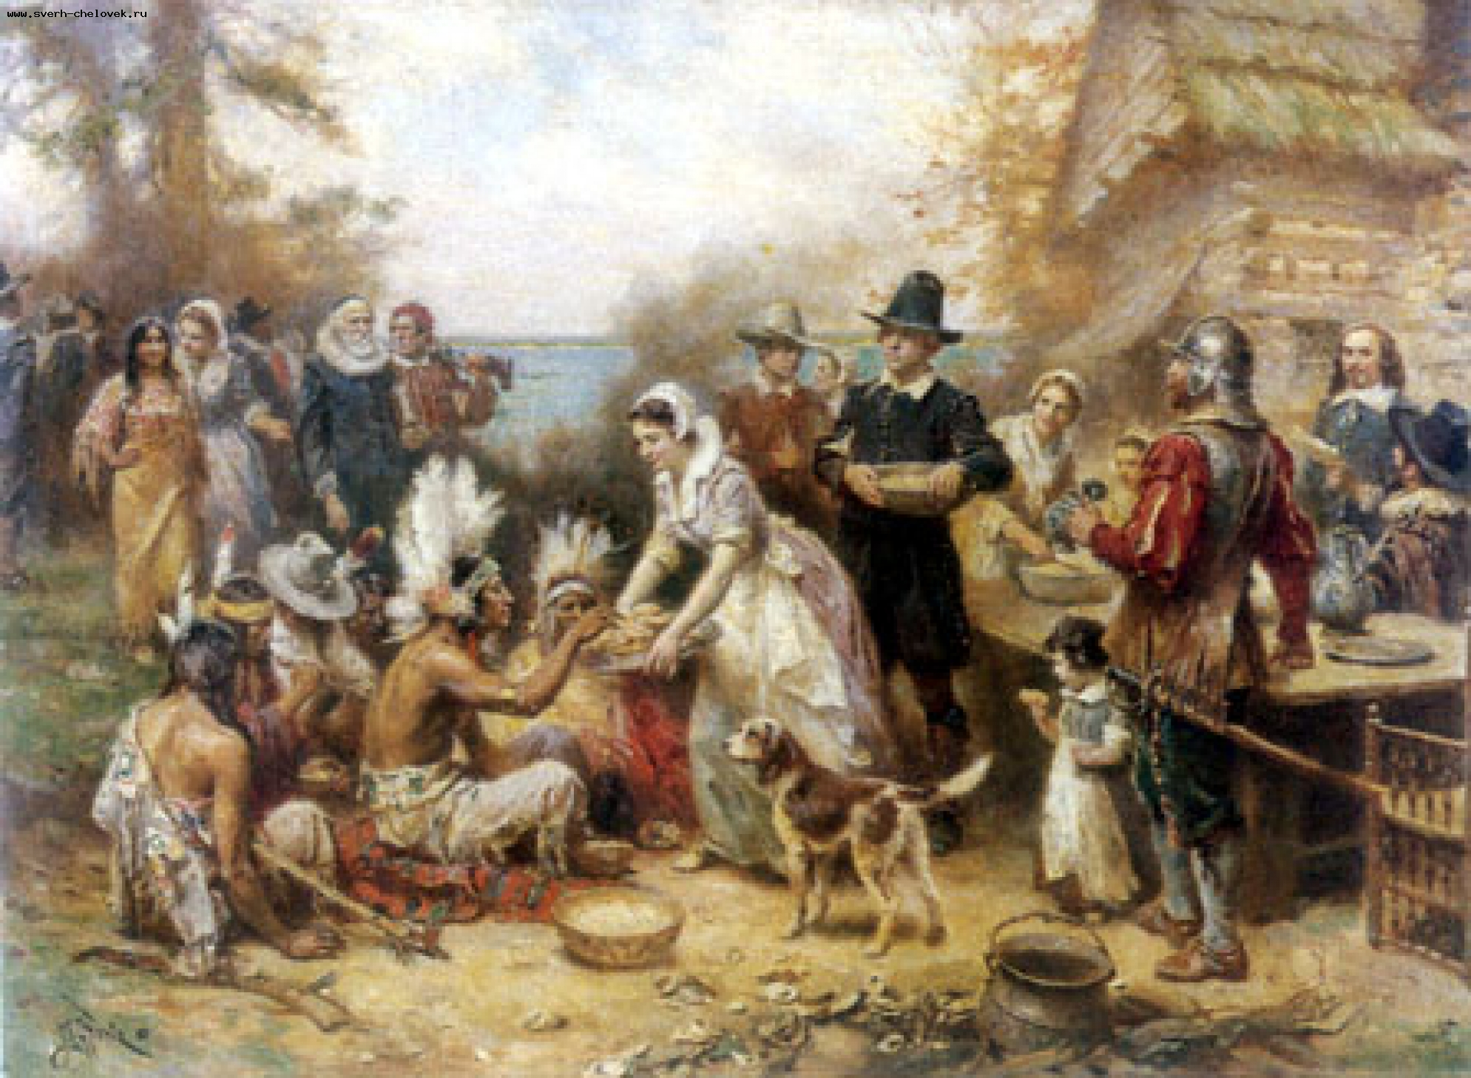
Historically, Thanksgiving began as a tradition of celebrating a harvest feast to give thanks by the Pilgrims.

Slide 5
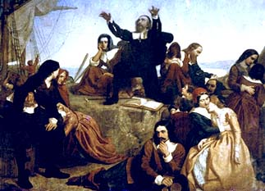
Once upon a time in the land of England, there lived a small group of people called Pilgrims. The Pilgrims were unhappy, and left England because they did not agree with the religion.

Slide 6
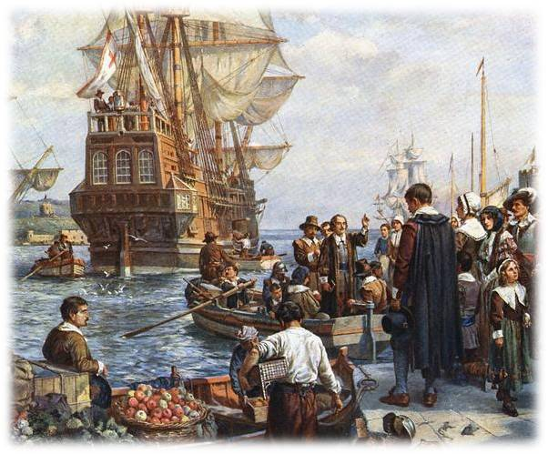
On September 6th, 1620 the Pilgrims, 102 men, women, and children, left England on a small ship, the Mayflower.

Slide 7
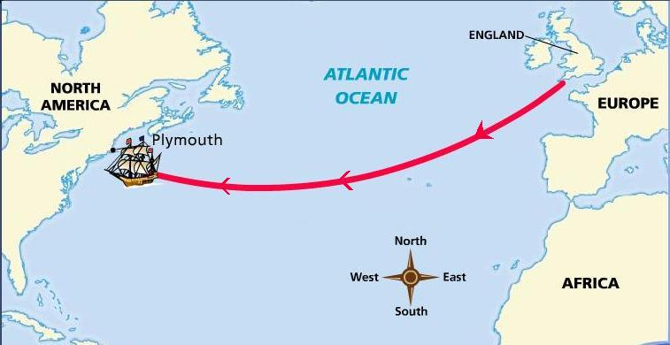
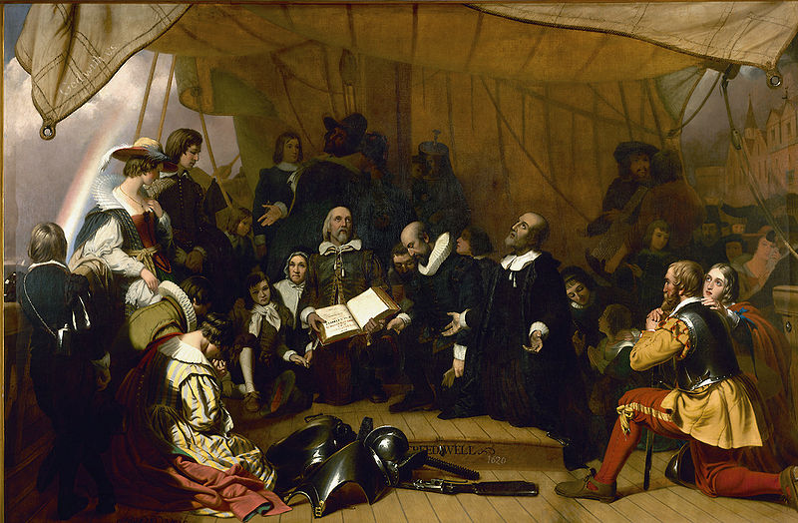
They went to America in 1620 and sailed for 66 dangerous days.

Slide 8
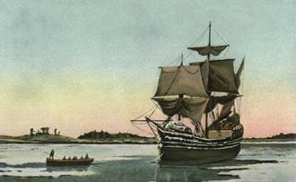
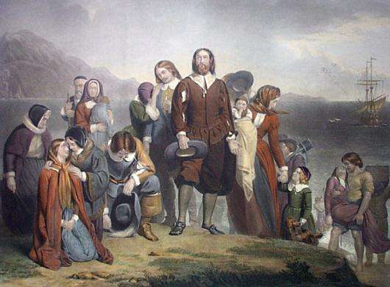
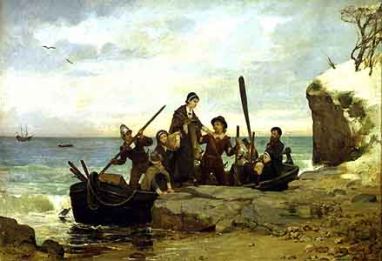
On December 11th , they landed at Cape Code where there was some cleared land, a stream with clear pure water, and a high hill that could be fortified.

Slide 9
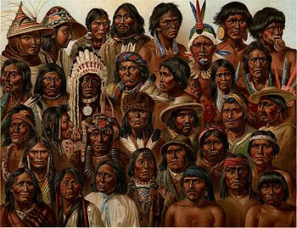
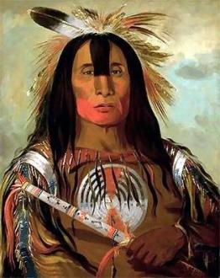
They called their new home New England, but they were not the first people to live there. The Wampanoag Indians lived there. They were native to the area.

Slide 10
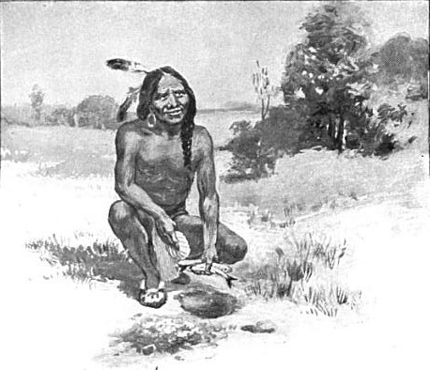
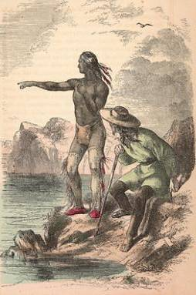
Only Squanto spoke English well. He became the interpreter between the Indians and the Pilgrims.

Slide 11
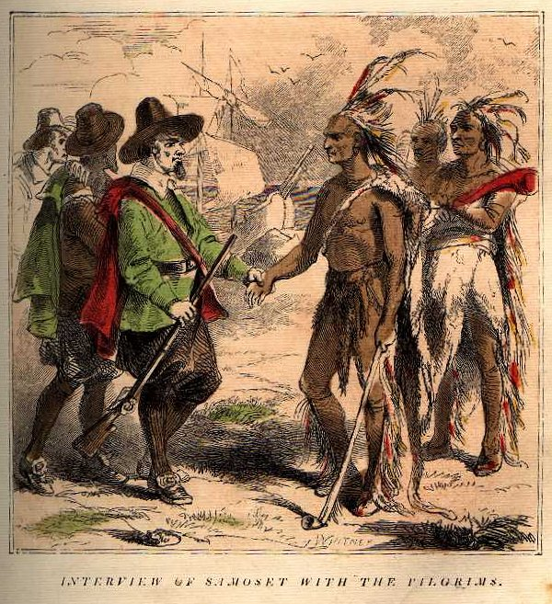
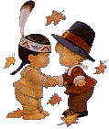
Indians helped the white men very much. The Pilgrims, under the Indian’s direction, caught fish and used them as fertilizer in planting corn, pumpkins, and beans. They hunted and fished for food.

Slide 12
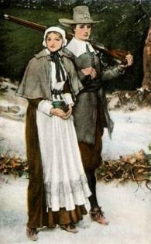
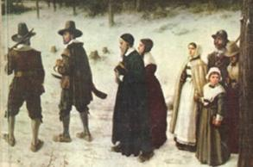
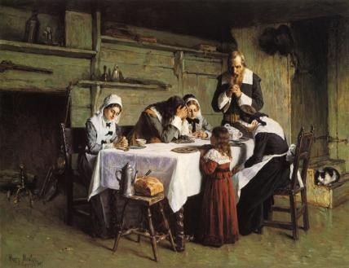
The Pilgrims’ first winter was very difficult. Many of them died because it was very cold and they had little food.

Slide 13
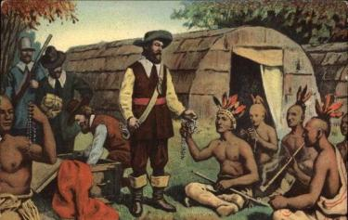
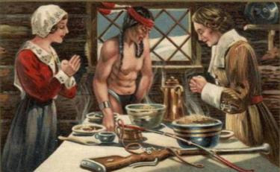
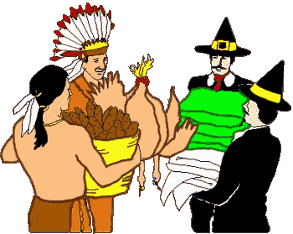
The Wampanoag Indians helped them. They brought vegetables and food, taught the Pilgrims to survive in New England.

Slide 14
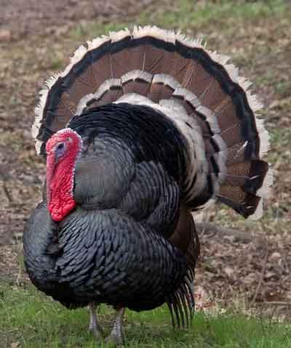
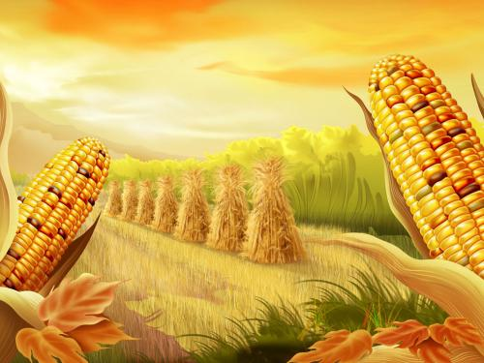
They also taught the newcomers how to plant the corn.
The Indians showed the best way to catch fish, to hunt deer and turkeys.

Slide 15
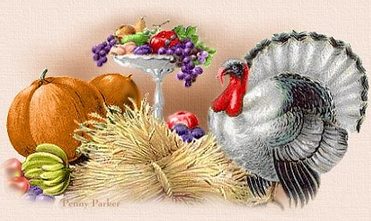
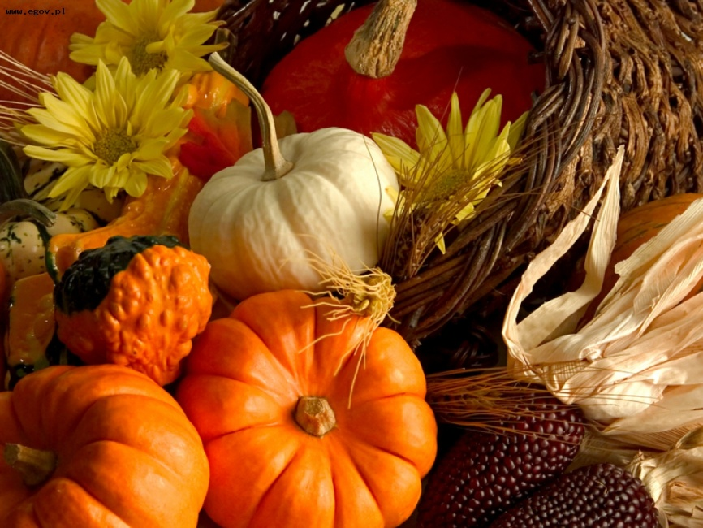
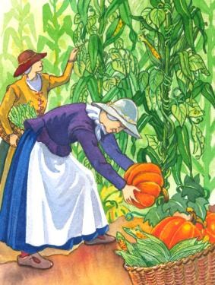
In the autumn of 1621 the settlers had a great harvest.

Slide 16
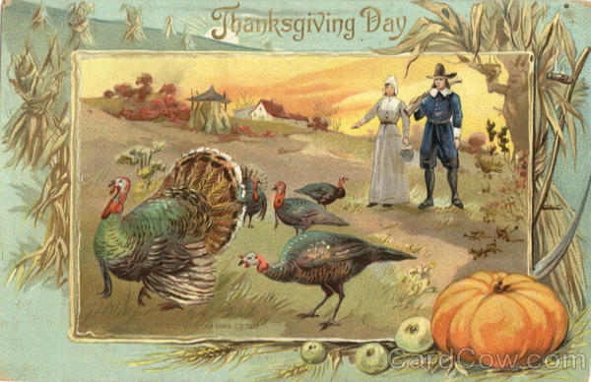
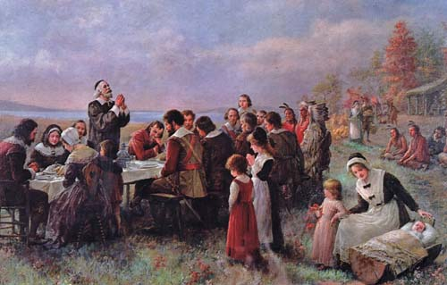
The "first Thanksgiving" was celebrated by the Plymouth colonists in 1621 (somewhere between Sept.21 and Nov.9)

Slide 17
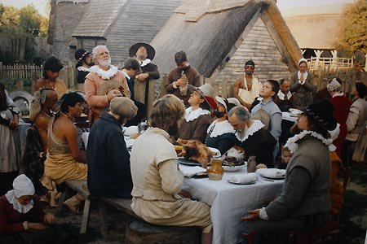
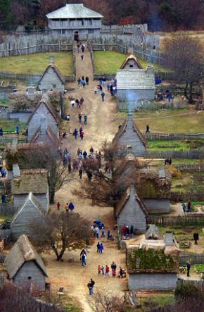
They gave thanks for their new home, first harvest and for surviving the first terrible Massachusetts winter.

Slide 18
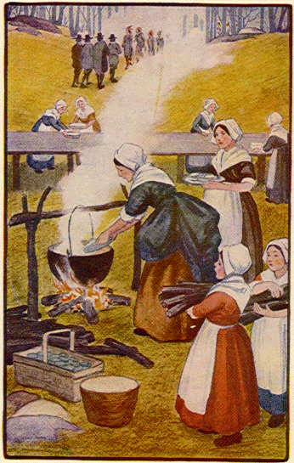
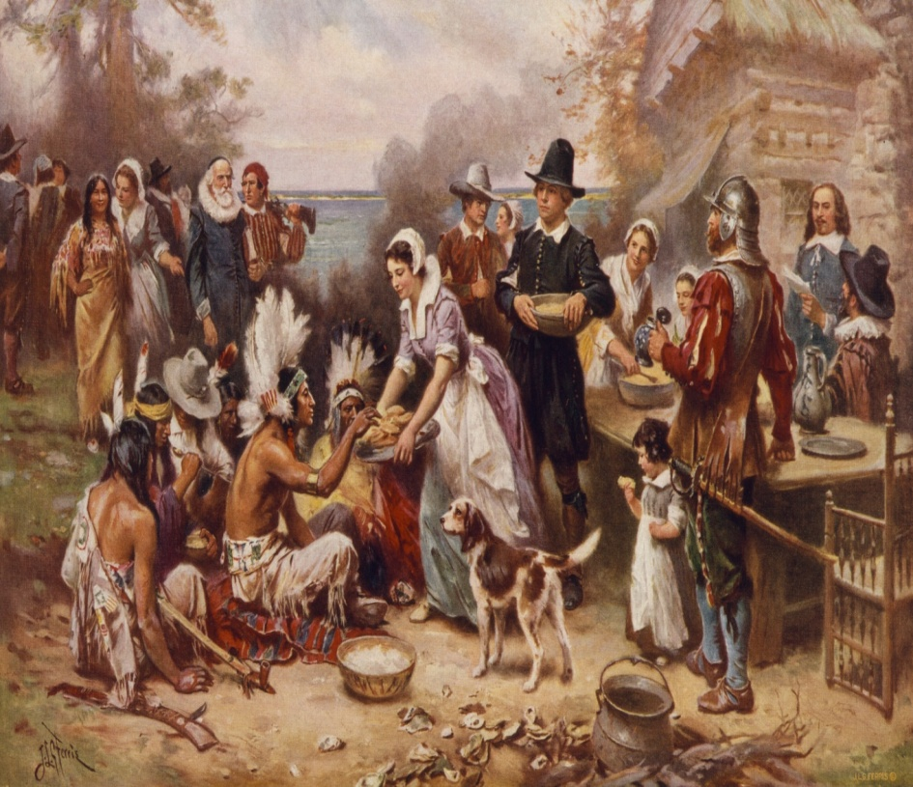
They prepared a holiday dinner and invited their Indian friends to join them. The feast lasted three days. The Pilgrims and Indians ate outdoors and competed together in tests of skill and strength.

Slide 19
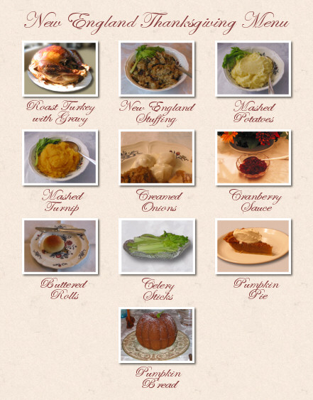
The feast probably consisted of the following items: Seethed [boiled] Lobster Roasted Goose Boiled Turkey Fricase of Coney Meal with dried Whortleberries Seethed Cod Roasted Duck Stewed Pumpkin Savory Pudding of Hominy Fruit and Holland Cheese

Slide 20
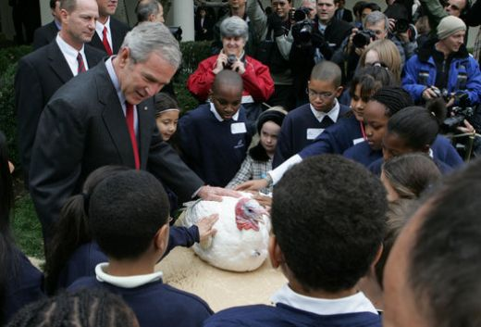
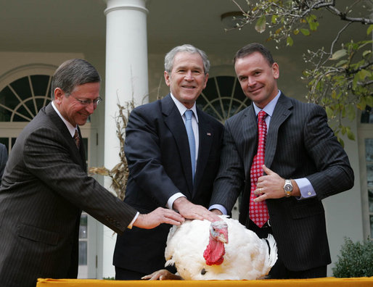
Thanksgiving remained a custom unsanctified by law until President Roosevelt signed a bill on 26 November 1941 that established the fourth Thursday in November as the national Thanksgiving public holiday .

Slide 21
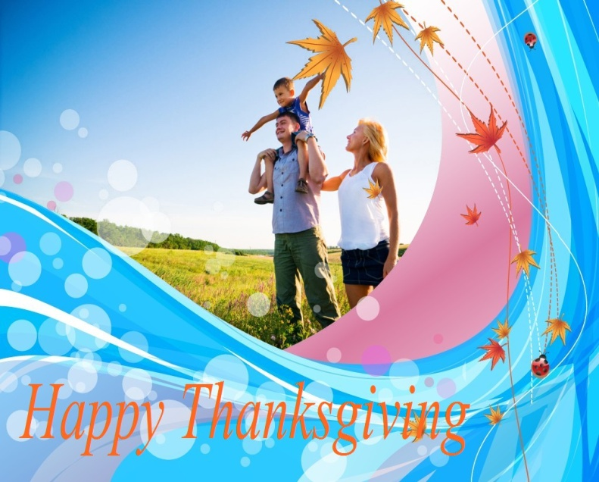
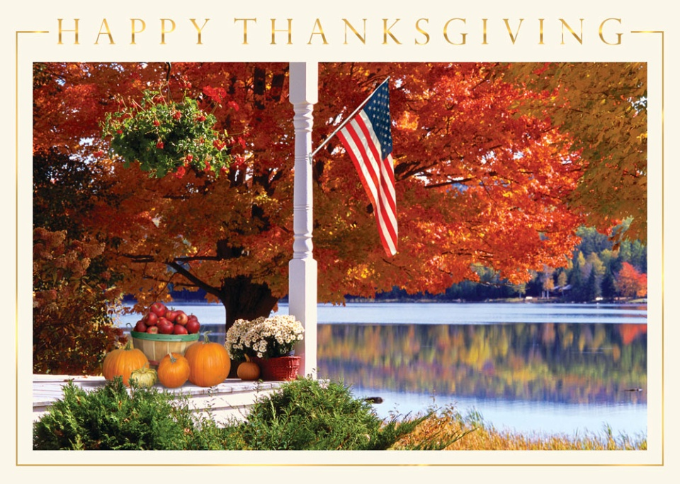
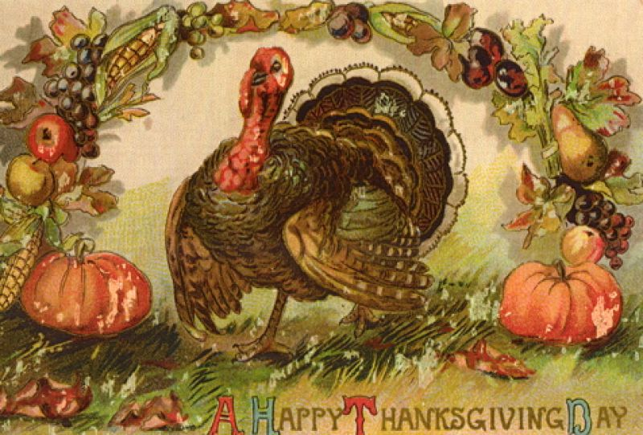
Thanksgiving Cards should be sent to everyone who has helped you in your life.

